Slide 1
Firearm Violence Analysis and Modeling
Barnes, Chloe
Dallas, Ryan
Luedtke, Terry
Robinson, Shiraz
Threat, Tiandra
Notes:
Firearm mortality varies hugely by state, and the policies and guns laws in each state varies too. We built multiple models and a dashboard to compare firearm death rates with a cumulative gun law strength score with U.S. firearm mortality data collected from 2014-2023.
We used two initial datasets, one from the CDC that gave us firearm mortality data from 2014-2023 for each state. The second is actually a database recording U.S. state laws regarding firearms, and this had data all the back from before 1900.

Slide 2
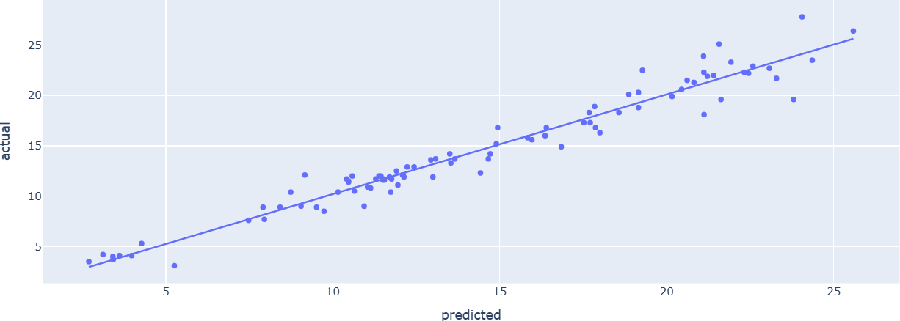
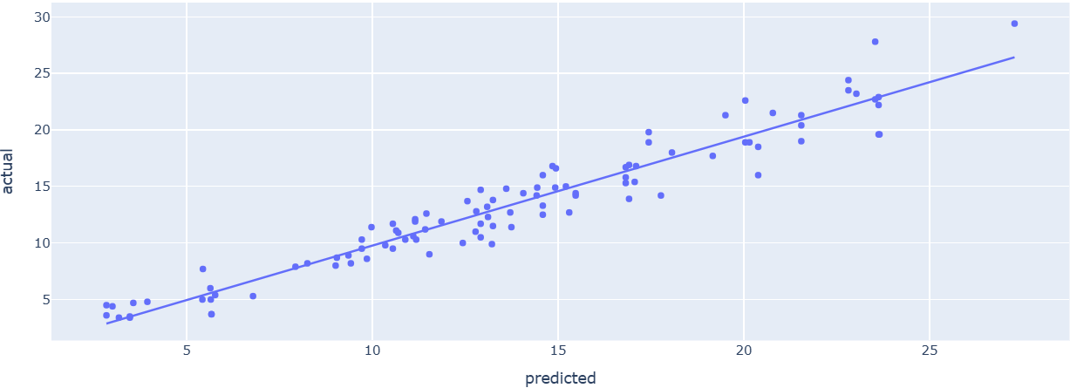
Research Question 1:
Can we predict firearm death rates based on gun law characteristics?
Basic Multi-Linear Regression Models
 | Dataset 1 | Dataset 2
Adj r^2 | 0.948 | 0.904
RMSE | 1.277 | 1.598

Slide 3

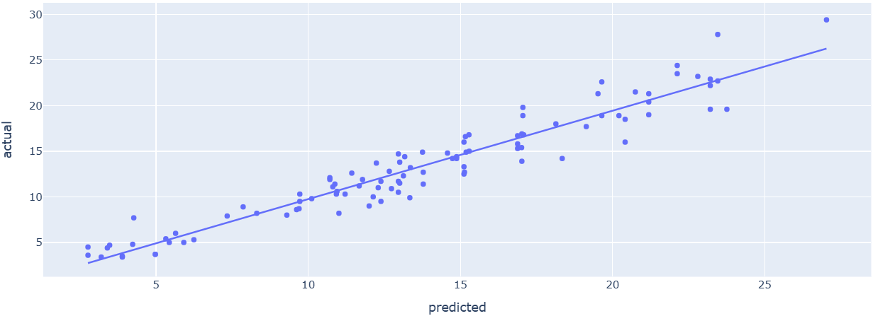
Research Question 1c:
Can we predict firearm death rates based on gun law characteristics?
Ridge-Regressed Models
 | Dataset 1 | Dataset 2
Adj r^2 | 0.938 | 0.893
RMSE | 1.280 | 1.689

Slide 4
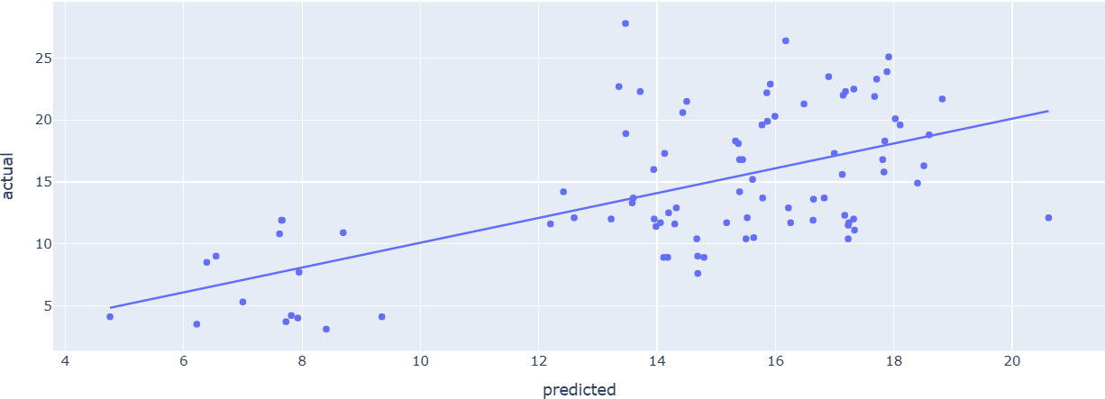
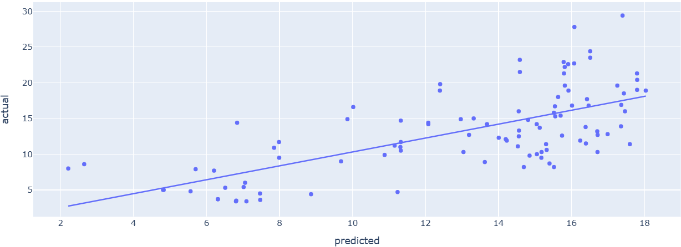
Research Question 1c:
Can we predict firearm death rates based on gun law characteristics?
Principal Component Model
 | Dataset 1 | Dataset 2
Adj r^2 | -1.234 | -1.689
RMSE | 4.602 | 4.280

Slide 5
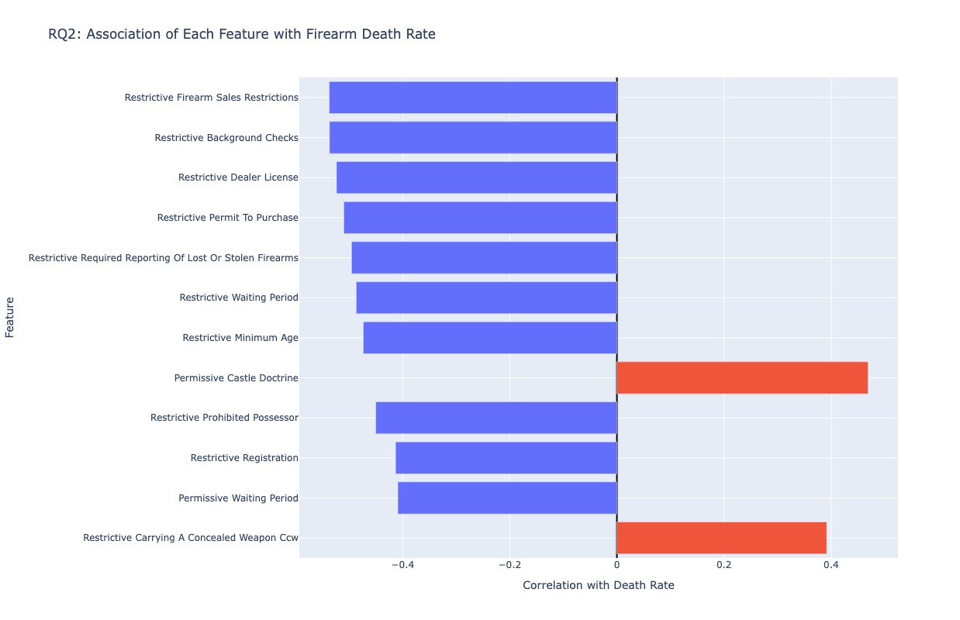
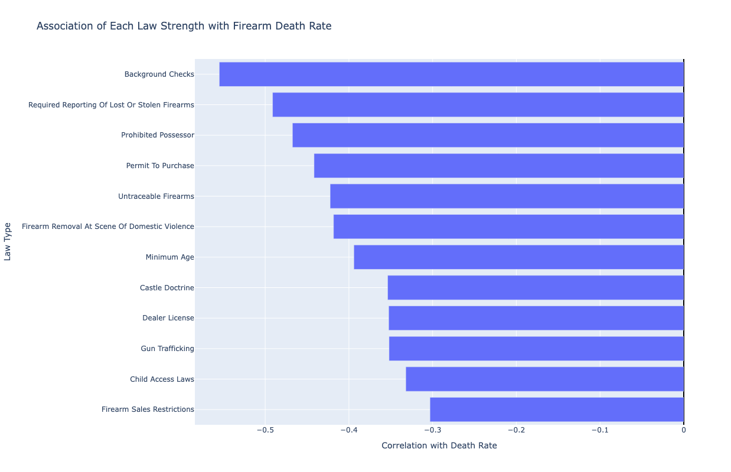
Research Question 2:
Which specific law types are most strongly associated with death rates?
Correlation of Features to Firearm Death Rates
Correlation of Law Strengths to Firearm Death Rates

Slide 6
Research Question 3:
Can we identify distinct groups of states based on gun law profiles?
Methods: K-Means (k=3), Hierarchical Clustering, PCA visualization.
Key Findings:
  Three clusters emerge: Most Restrictive, Moderately Restrictive, Least Restrictive.
  Strong alignment between law strength and mortality rates.
  PCA shows clear separation; 45.6% variance explained.
  Interpretation: U.S. gun policy landscape is tri-modal, not continuous.
  Validation: KNN & MLP classifiers achieve 75% accuracy in predicting cluster membership.

Slide 7
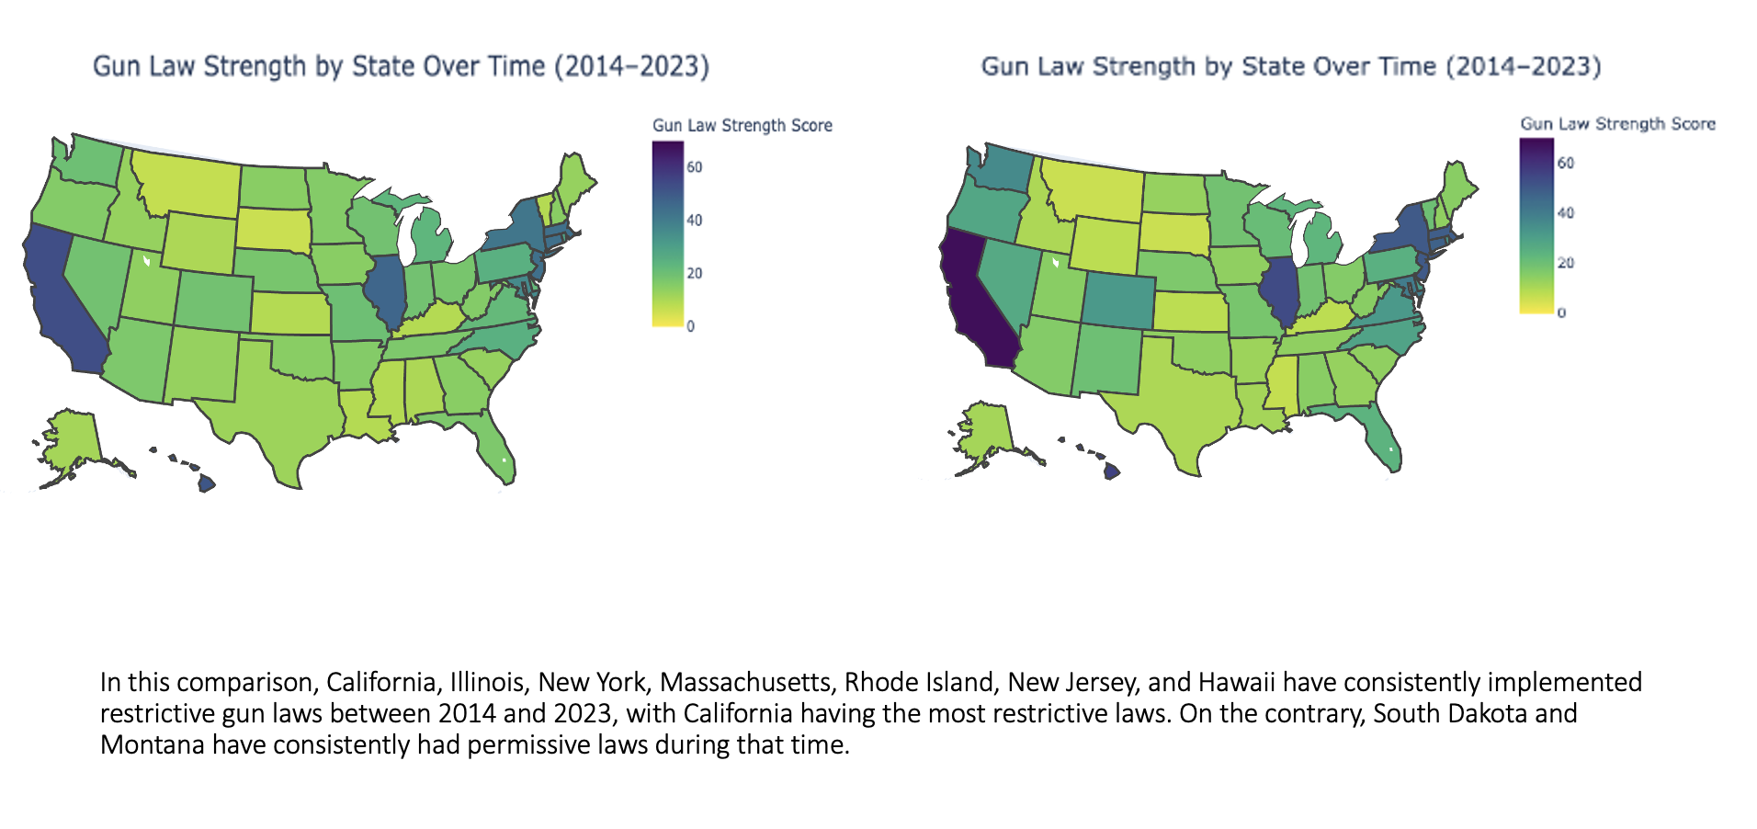
Research Question 4a:
Temporal Trends of Gun Law Strength

Slide 8
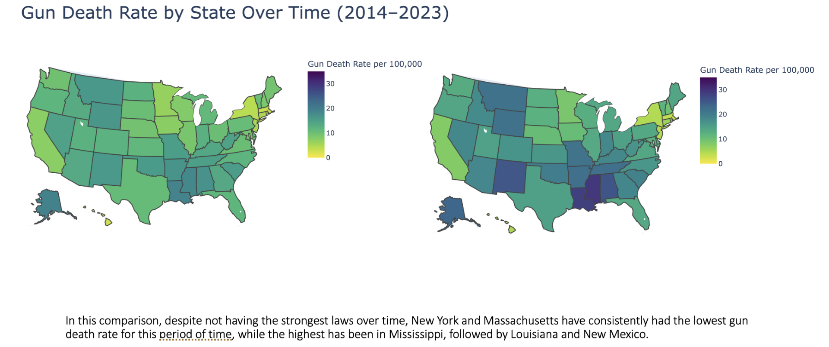
Research Question 4b:
Temporal Trends of Gun Death Rate (per 100k)

Slide 9
Conclusions:
Complex stochastic process, difficult to predict with deterministic methods
There are correlations and indications of a relationship between legislation passed and rates of gun deaths

